Slide 1
Demand Response with GridLAB-D

Slide 2
Presentation Overview
Part 1: What is Demand Response (DR)?
Part 2: The Wide World of DR
Part 3: Implementing DR in GridLAB-D

Slide 3
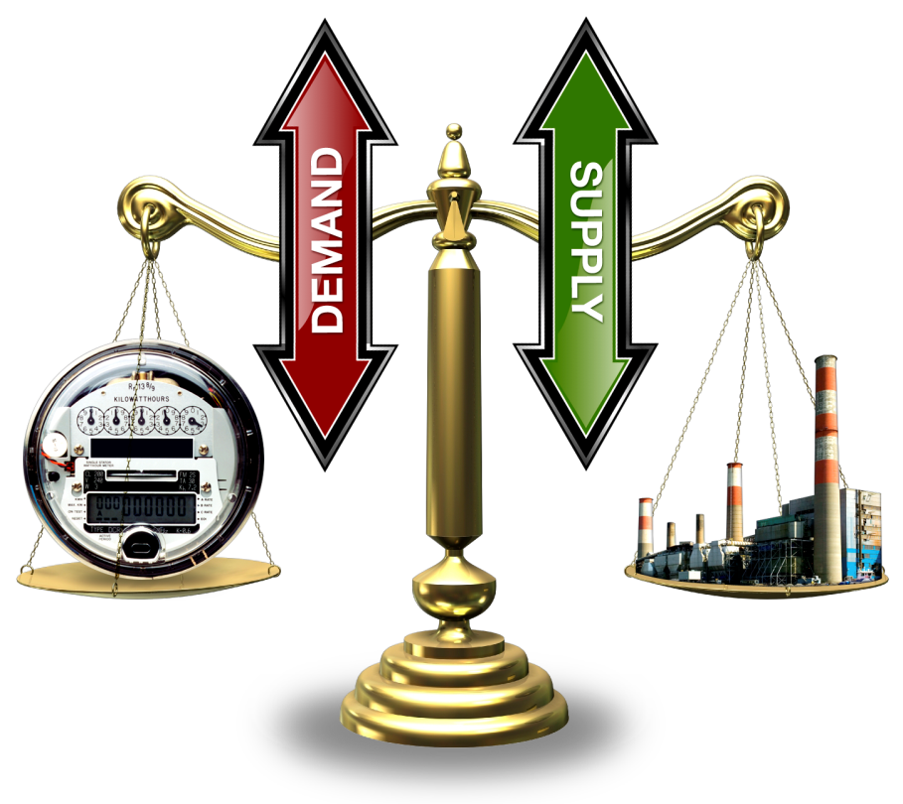
Part 1: What is Demand Response (DR)?
To maintain frequency on an interconnect power system it is necessary to maintain a balance between generation and load plus losses.
Traditionally the load has not actively participate in the balancing process. If you turn on the light switch when the power system is in a stressed condition you will still receive power.
Since the load does not actively participate it is necessary for the generators to account for all imbalances.

Slide 4
Market Concept
Bids submitted by two primary types
  Suppliers – bid in amount they can provide and what they want to charge for it
  Demanders – bid in amount they wish to use and how much they are willing to pay for it
Market closes and “clears”
  Bidding process is stopped
  Supply and demand bids are arranged
  Meeting point of the two curves is the “clearing price and quantity” of the auction

Slide 5
Price Elasticity of the End Use Loads
Price
Demand
(elastic)
Demand
Price
($/MW)
(inelastic)
Price, mitigated
Supply
Quantity (MW)
Notes:
Changing today's inelastic demand to dynamically respond to the market is broadly recognized as the key to stabilizing prices … and allowing lead time to add capacity at lower risk.
The technology to create a much more elastic demand curve must move quickly into the market, and dynamic markets for supply and demand must be created on many levels and scales.

Slide 6
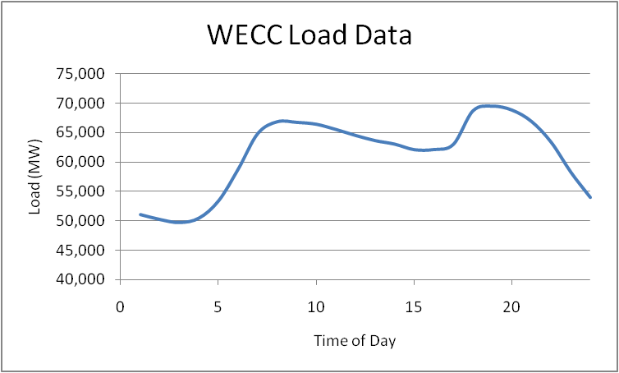
Demand Response cont.
Because the load is not an active participant in balancing, the rest of the electricity infrastructure has been designed and operated to account for this.
As a result, infrastructure has been constructed to accommodate peak system conditions, similar to a highway system.
In addition to the size of the system, operational methodologies have been implemented to account for the behavior of end use load.

Slide 7
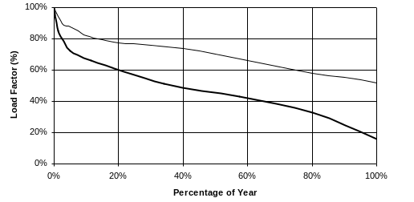
Utilization of Electricity Infrastructure
Hourly Loads as Fraction of Peak, Sorted from Highest to Lowest
90%
generation
75%
5% = ~400 hrs/yr
distribution
5%
(8,760 hrs)
25% of distribution & 10% of generation assets (transmission is similar),
worth of 100s of billions of dollars, are needed less than 400 hrs/year!
Notes:
Grid assets must be sized to meet peak demand, but their overall utilization over the course of the year is low.
These are load duration curves in which the loads for the year (hourly in this case) are sorted from highest to lowest.
When normalized to the peak load (100% load factor), they illustrate the utilization of an asset.
This plot shows the utilization of generation and a typical distribution feeder in the U.S.
Note that the average utilization (50-th percentile) for the year for generation is about 70%.
For distribution it is below 50%.
These do not include the reserve margins, which lower utilization of actual capacity substantially.
(CLICK) Note how much capacity is needed for only 5% of the hours of the year (438 hours):
(CLICK) 25% of our distribution capacity
(CLICK) and about 10% of our generation capacity exist only to serve loads for those few hours.
If we can displace those loads with demand response, distributed generation, and efficiency measures …
That would represent huge reductions in needed infrastructure.

Slide 8
Demand Response cont.
In order for Demand Response to be effective there must be a form of control input.
The input is often a control signal in the form of a price signal, which is sent by the utility or other controlling entity.
While price signals are one type of control signal, most any variable could potentially be used.

Slide 9
Demand Response cont.
Demand Response is the concept that end use loads can be active participants without impacting the end use customer.
With load as an active participate there are multiple benefits that can be obtained.
Demand Response can be used for:
  Peak load reduction
  Regulating services
  Emergency Conditions

Slide 10
Peak Load Reduction
Power systems exhibit non-linear characteristics which results in variable efficiencies.
  Under heavy loading conditions losses are higher due to non-linear I²R losses.
  During peak times less efficient “peaking units” may need to be run.
As a result, systems with high peak load characteristics are less efficient and more expensive to operate.

Slide 11


Peak Load Reduction cont.
Line Losses
Generator Efficiencies
For a typical power line, if you double the load, you will quadruple the losses.
Heat Rate: The number of British Thermal Units (Btu) required to produce a kWh of electrical power.
Coal Steam: 10,818 Btu/kWh
Combined Cycle: 8,931 Btu/kWh
CT/Diesel: 11,667 Btu/kWh

Slide 12
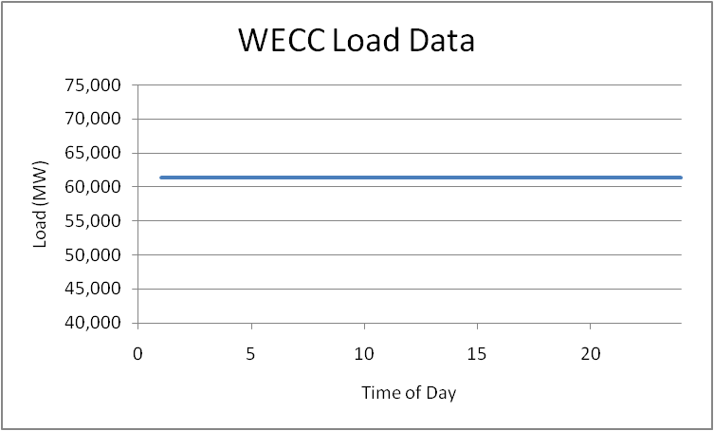
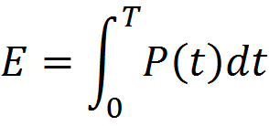
Optimal Peak Reduction
Because the load is not an active participant in balancing, the rest of the electricity infrastructure has been designed and operated to account for this.
As a result, infrastructure has been constructed to accommodate peak system conditions, similar to a highway system.
If the load is “smoothed” then the same energy could be delivered with less infrastructure.

Slide 13
Realistic Peak Reduction
It is not realistic to expect that the load can be completely flattened.
Because of the non-linear characteristics of power systems reducing the highest peaks will yield the greatest benefits.
Engaging Demand Response only at peak times will yield some of the most significant benefits, while affecting the end use consumers the least.

Slide 14
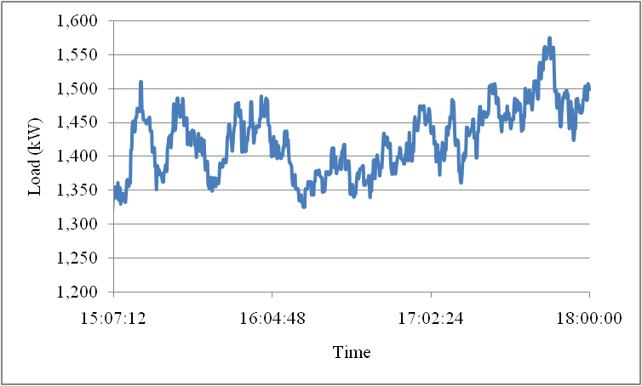
Regulating Services
On a typical distribution feeder the load will exhibit variations at different frequencies.
In order to maintain the generation-load balance generators must change their output continually.
Demand response can potentially be used to “smooth” the fluctuations by providing regulating services.

Slide 15

Emergency Conditions
Blackout are complicated processes involving millions of components.
Heavy load conditions are often cited as contributing factors to cascading blackouts.
Currently, there is no feedback to tell the customer that turning on a load is endangering a system which is stressed.
Demand response can be used to reduce load automatically in order to prevent a large scale cascading blackout.

Slide 16
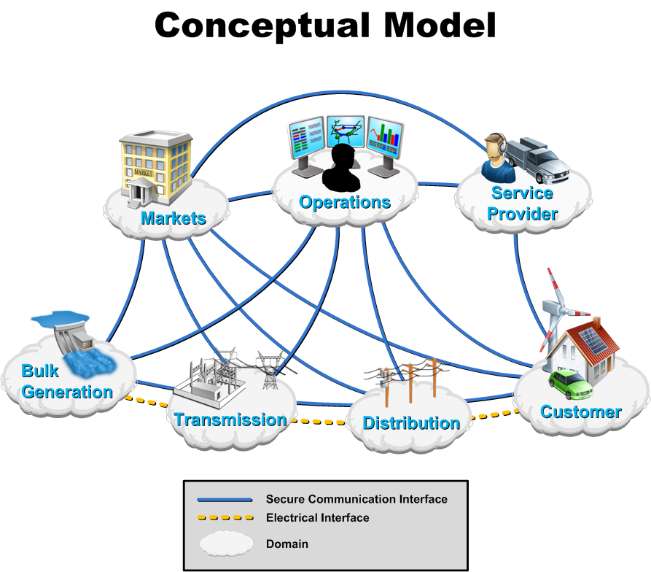
The Wide World of DR

Slide 17
Types of Load Control
Direct Load Control
Demand Response
  Time Of Use (TOU)
  Critical Peak Price (CPP)
  Real Time Price (RTP)
    Passive
    Double Auction
Distributed Control (Grid Friendly Appliances)

Slide 18
Direct Load Control
In a direct load control scenario the utility has a direct control path to the appliance controller.
Once the permission of the end user is obtained, the utility can control the end use load within the limits of a contract.
The end user is then given a monetary rebate for allowing this type of control.
Utilities like this type of system because there is a “big red button” that they can push and they know exactly how much load will respond.

Slide 19
Time Of Use (TOU)
Time Of Use can be implemented in 2 ways:
  Through a social system.
  Through a hardware system.
The social system informs the customer that electricity costs different amounts at different times and lets the end user adjust to this fact.
In the hardware system the price changes and the appliance will response immediately.

Slide 20
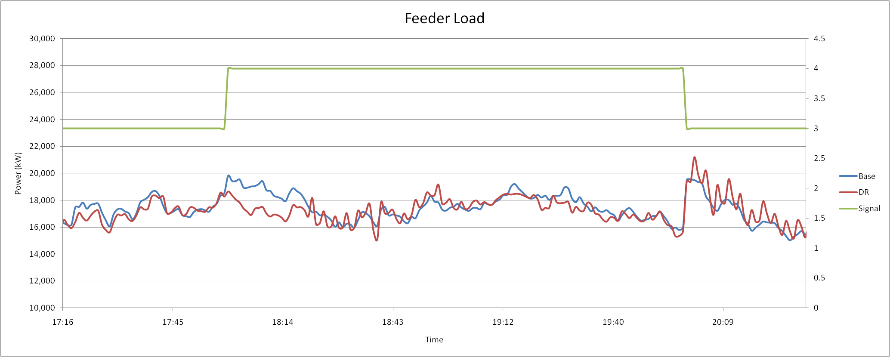
The Demand Response Rebound

Slide 21
The Demand Response Rebound
Demand response operates by adjusting the consumption of energy
  For a thermostat this results in a warmer (cooler) residence
  For a hot water heater this results in a lower water temperature
There must be a thermal mass or a process to defer
In either case there is a limited resource
  The HVAC system can defer operation but it must eventually turn on
  A dryer can operate at a lower temperature, but eventually the necessary energy must be consumed to dry the clothes
  The magnitude of the resource depends on technical as well as social limits/preference
With a Time of Use (TOU) or Critical Peak Price (CPP) a rebound can be experienced

Slide 22
The Demand Response Rebound Cont.
TOU and CPP can be implemented in 2 ways
  Socially: people are told of the TOU rate structure
  Hardware: signals are sent to hardware (appliances or home EMS)
With a social implementation a rebound is not likely
With a poorly designed hardware implementation, it is likely
One method to avoid the rebound effect is to implement a full Real Time Price (RTP) with a double auction
  RTP is technically effective
  RTP is hardware intensive

Slide 23
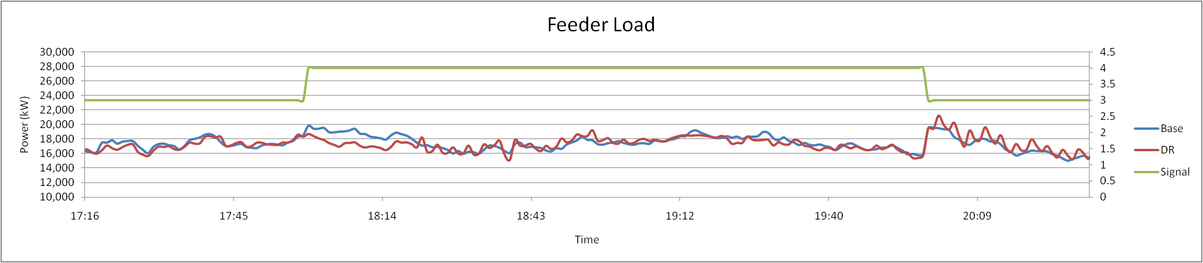
The Demand Response Rebound

Slide 24
Critical Peak Price (CPP)
A CPP system generally operates as a TOU system, except for certain times of the year.
Given notice, customers are subjected to a CPP which is extremely high with respect to the normal prices.
This signal is used to offset the impacts of severe weather or fluctuations in fuel prices.
The utility is only allowed to declare a CPP a fixed number of times, so they must select them carefully.

Slide 25
Real Time Price (RTP)
A real time price is similar to a TOU price with a hardware implementation except that the price can change every 5 minutes.
Because it changes so often it is necessary to implement this with hardware.
A RTP is a more accurate representation of the true cost of consuming electrical energy.

Slide 26
Real Time Price (RTP) cont.
An RTP can represent many different components of a power system.
It can also be an aggregate “signal” with inputs from multiple sources.
  Wholesale power cost
  Transmission level congestion cost
  Distribution level congestion cost
  Regulation cost
By using different components in a cost signal many stakeholders can be represented without the end user having to understand the complexity of a power system.
The price signal sent to the end user may not be the actual cost of power, but a number which indicates the relative cost of power at a given time.

Slide 27
RTP-Double Auction Market
Price
Demand
(elastic)
Demand
Price
($/MW)
(inelastic)
Price, mitigated
Supply
Quantity (MW)
Notes:
Changing today's inelastic demand to dynamically respond to the market is broadly recognized as the key to stabilizing prices … and allowing lead time to add capacity at lower risk.
The technology to create a much more elastic demand curve must move quickly into the market, and dynamic markets for supply and demand must be created on many levels and scales.

Slide 28
RTP-Double Auction Market
A double auction has the advantage that rebound effect will not be experienced.
A true double auction can address many issues at once, and include bidding from load, central generation, and distributed generation.
When a market is “cleared” there can be issues of equitable solutions.
A double auction market requires a significantly more capable communications system than a RTP system.

Slide 29
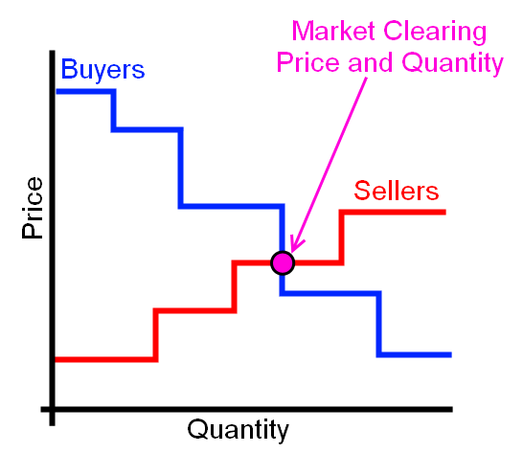
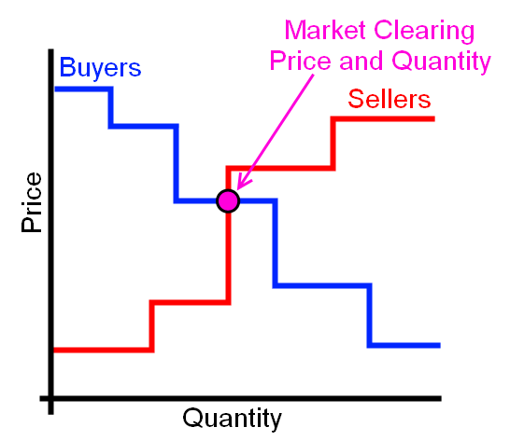
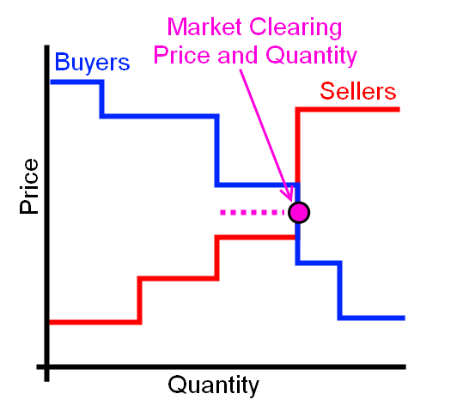
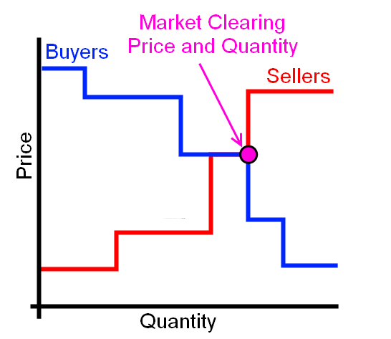
Part 3: Implementing DR in GridLAB-D

Slide 30
Market Objects
Passive Controller
Stubauction
Controller
Auction

Slide 31
Stubauction and Passive Controller Objects
Stubauction Object
Passive Controller Object
For a distribution feeder there is generally only a single auction object.
This object is where the price is actually cleared.
A player is generally needed to input a price signal for TOU, CPP, or RPT.
A player is not necessary for a double auction market.
A controller object must be placed on every device which will participate in the market.
A controller can be on a thermostat, a hot water heater, or any other load.
It is the device which tells the market how the load will willing to behave.

Slide 32
Stubauction Object
object stubauction {
name Market_1;
period 300;
object player {
file Price.player;
loop 365;
property current_market.clearing_price; };
object recorder {
property avg24,std24,last.P,current_market.clearing_price;
limit 2880;
interval 60;
file price_statistics.csv; };
}
The auction is responsible for determining the clearing price.
When using passive controllers a stub-auction is used.
In a stub-auction there is no clearing of the market, the clearing price is input through a .player file.

Slide 33
Passive Controller
(Thermostat)
k
k
Price*
P_{avg}
P_{clear}
T_{min}
T_{set}
T_{desired}
T_{current}
T_{max}
Temperature

Slide 34
Passive Controller
object passive_controller {
base_setpoint cooling3*1;
control_mode RAMP;
sensitivity 1;
expectation_obj Market_1;
expectation_prop avg24;
setpoint_prop cooling_setpoint;
state_prop override;
observation_obj Market_1;
observation_prop current_market.clearing_price;
mean_observation_prop avg24;
stdev_observation_prop std24;
range_low -1.500;
range_high 2.500;
ramp_low 1.333;
ramp_high 0.800; };
The passive controller does not send a bit signal to the market.
This implies unidirectional communications.
This controller is set for a 24 hour moving window for market values.
The moving window can be changed to any value.
Ramp and Range values set the “responsiveness” of the passive controller.

Slide 35
Price Player
2000-01-01 00:00:00,0.065139609
+1h,0.063279907
+1h,0.047926635
+1h,0.054980748
+1h,0.054144897
+1h,0.052692165
+1h,0.025675894
+1h,0.048756545
+1h,0.060731834
+1h,0.067444366
+1h,0.077139106
+1h,0.115129386
+1h,0.314471806
+1h,0.103280668
+1h,0.107517265
+1h,0.090978092
+1h,0.099465131
+1h,0.163445608
+1h,0.188779549
+1h,0.122554232
+1h,0.281734869
+1h,0.240559158
+1h,0.082833806
+1h,0.081005661
+1h,0.062340608
+1h,0.058395271
The price.player file reads a price into the auction object.
This price is used to represent the cleared price of power for a TOU or RTP market structure.
The example shows price in 1 hour time steps, but smaller or larger time steps can be used.
A price signal is then sent to every control and based on this signal and the controller values.
The load will then respond accordingly.

Slide 36
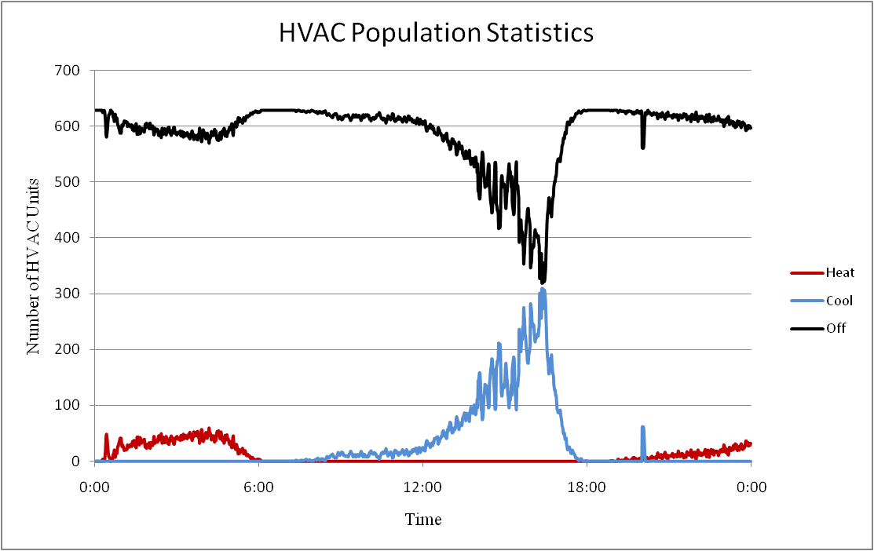
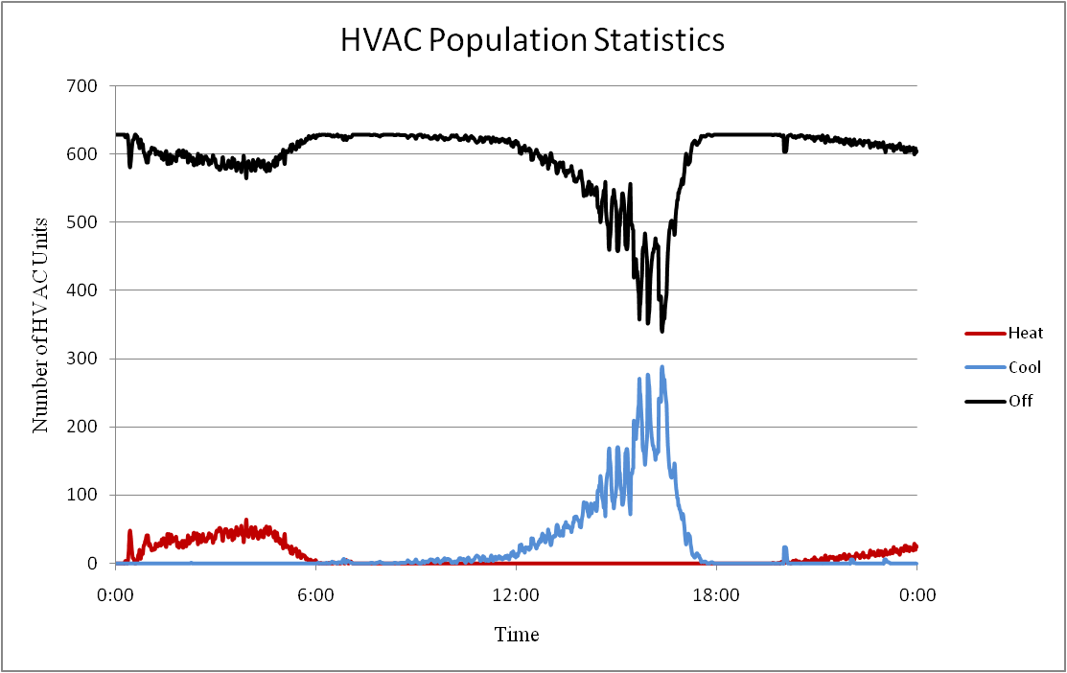
Population Statistics
At any given time in a system an HVAC unit will be in one of 4 operating modes.
  Off
  Cooling
  Heating
  Heating (AUX)
A control signal will distort these population statistics.
Multi-state physical models are used in the simulation so that we can understand how the control signal is distorting the statistics, and thus the power consumption.

Slide 37
Auction and Controller Objects
Auction Object
Controller Object
For a distribution feeder
A controller object must be

Slide 38
Exercise Passive Controller
Once again a modified version of the IEEE 13 node system is utilized.
In this assignment a stub-auction is implemented which is intended for passive controllers.
There are 629 houses each with a passive controller on their cooling systems.
A price signal is read into the stub-auction and the cooling systems of the houses respond according to the price and the set points of their controller.

Slide 39
Exercise 1
Run the CVR 13 Node system for 7 days with a constant price signal.
Plot the Regulator apparent power consumption, voltage at the regulator control node, price signals, and the HVAC system population statistics.
What is the peak load and how many HVAC units are in operation at this time?

Slide 40
Exercise 2
Run the CVR 13 Node system for 7 days with the default price signal.
Plot the Regulator apparent power consumption, voltage at the regulator control node, price signals, and the HVAC system population statistics.
How does the system operate with the price signal compare to without?

Slide 41
Exercise 3
Develop a control signal, i.e. price signal, that you think optimally controls the system. Explain your basis for this control signal.
Run the CVR 13 Node system for 7 days with the custom price signal.
Plot the Regulator apparent power consumption, voltage at the regulator control node, and the HVAC system population statistics.
How does this signal perform.
What is your opinion of a passive control signal?

